Slide 1
Nutrition Data Science
Michelle Davenport, PhD, RD (Quantitative Nutrition)
Noah Gift, ML Lecturer (Berkeley, Davis, Northwestern)

Slide 2
Harvard and The Sugar Industry
1950 Sugar Research Foundation low-fat (high sugar) diet.
1965 sugar linked to heart disease
Gave 50k dollars to two famous Harvard Nutritionists
Harvard’s Dr. Hegsted reassured the sugar executives. “We are well aware of your particular interest,” he wrote, “and will cover this as well as we can.”

Slide 3
Exploding Sugar Consumption

Slide 4
Nutrition confusion
Research Funding
Industry funding = Industry results
Design study
Biases, limitations and inherent design and methodical flaws
Inconclusive or biased results
Generalized recommendations to the public
Censorship of final recommendations by government to benefit lobbyists

Slide 5
Sugar Confusion
Sugar Association; >50% of sugar studies funded, all show no link between sugar and disease
Research Funding
Study Design
Healthy user effect and health study effect
Inconclusive or biased results
USDA censored “sugar-sweetened beverages should be reduced” in final recommendations
2015 Dietary guideline:
“Limit added sugar to less than 10% of caloric intake”

Slide 6
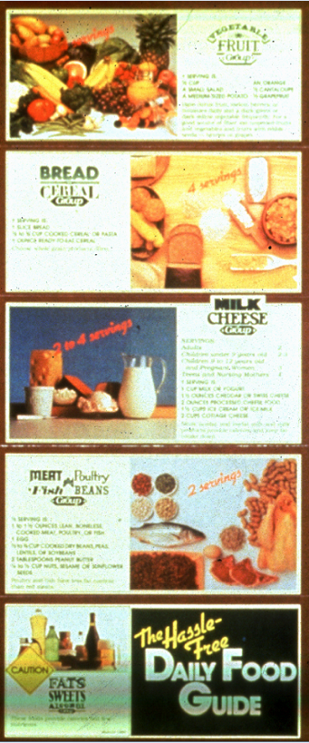
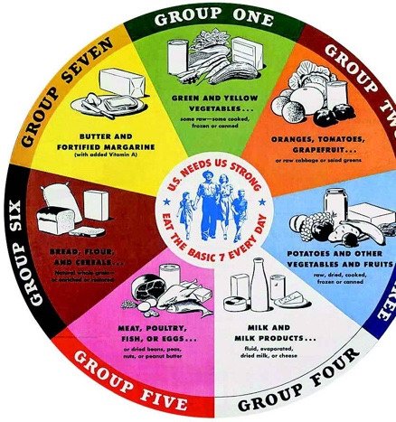
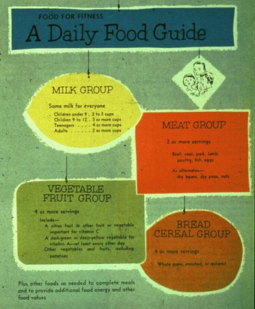
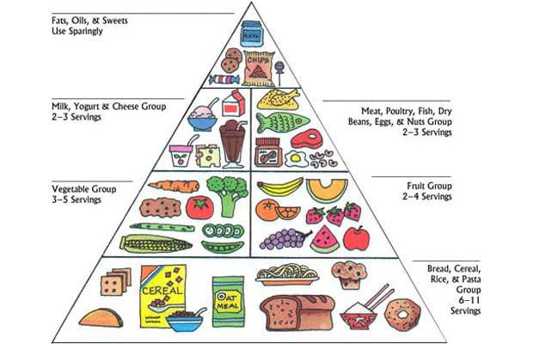
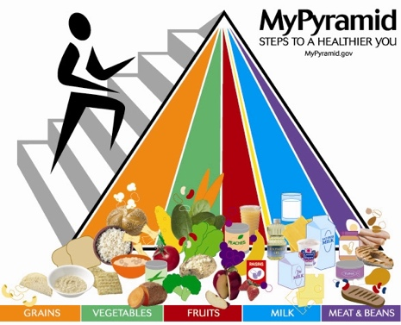
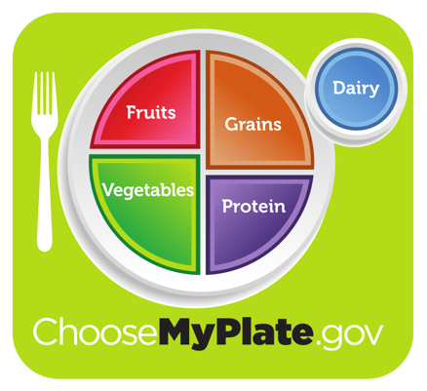
1955
“Basic 4”
1992
Food pyramid
2011
Myplate
1977
“Hassle-free food guide” by Dr. Hegsted
(Sugar becomes a food group!)
2005
Mypyramid
2019+
???
1943
“Basic 7”
Notes:
1977 Same Harvard doctor adds sugar as food group

Slide 7
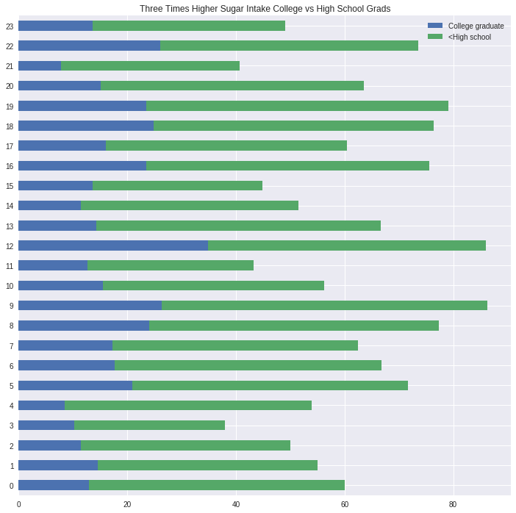
Sugar - Data Science Approach

Slide 8
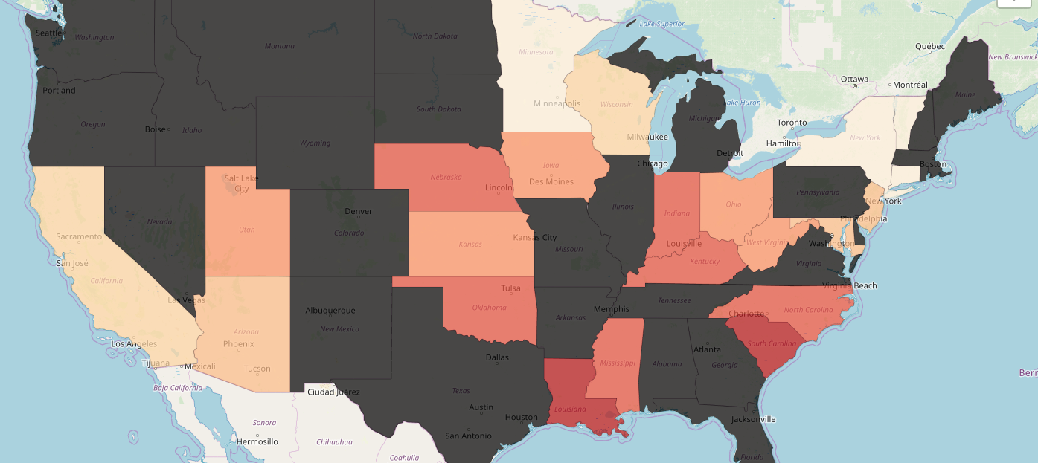
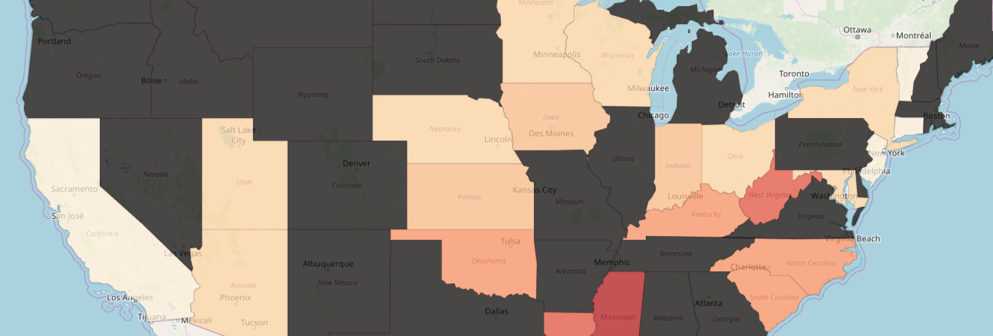
Sugar - Data Science Approach
3X Higher Sugar Intake College vs < High School

Slide 9
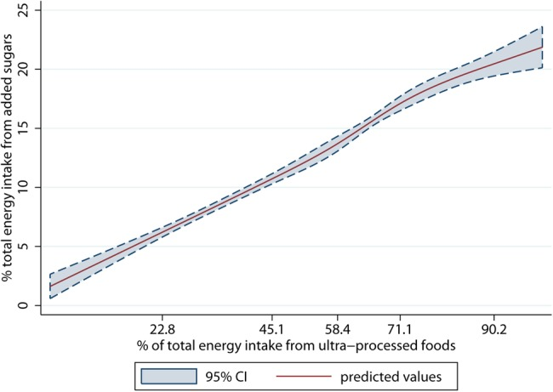
Sugar - Where is it coming from?
Ultra-processed Foods
90% of added sugars consumed in USA
Food Industry!

Slide 10
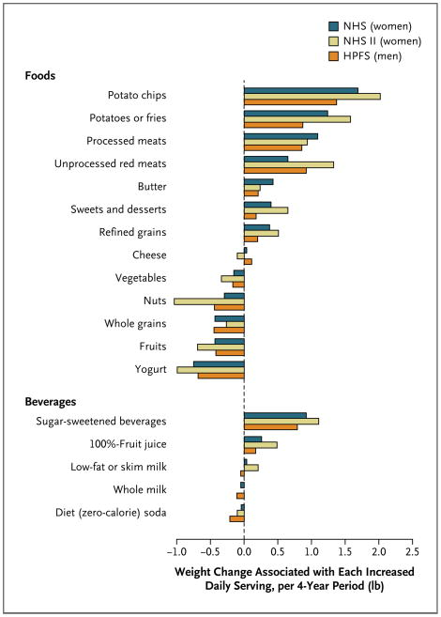
Long-Term Weight Gain or Loss by Daily Serving

Slide 11
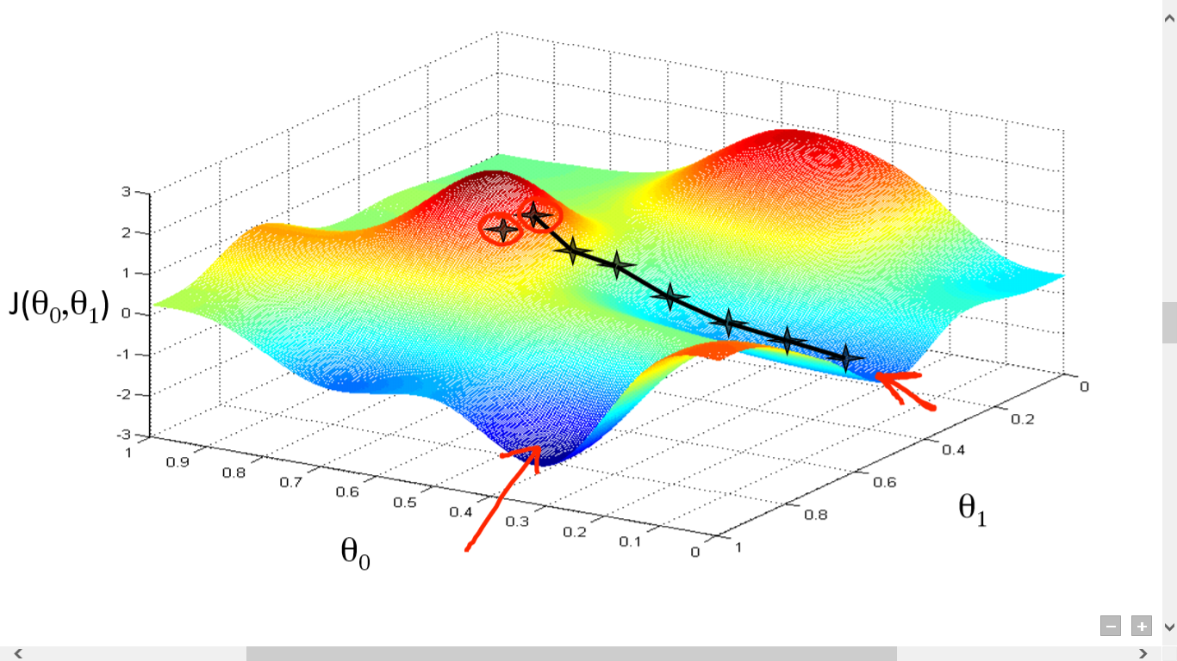
Local vs Global Minimum

Slide 12
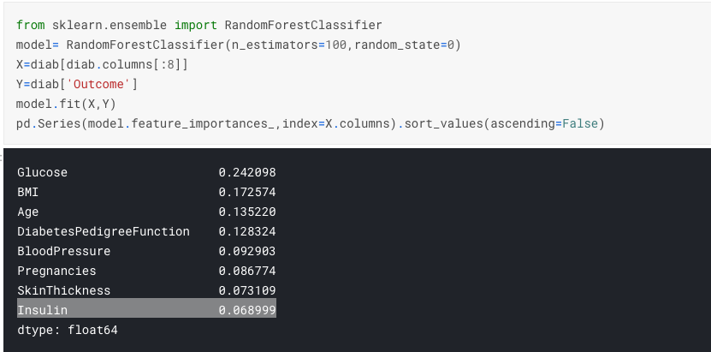
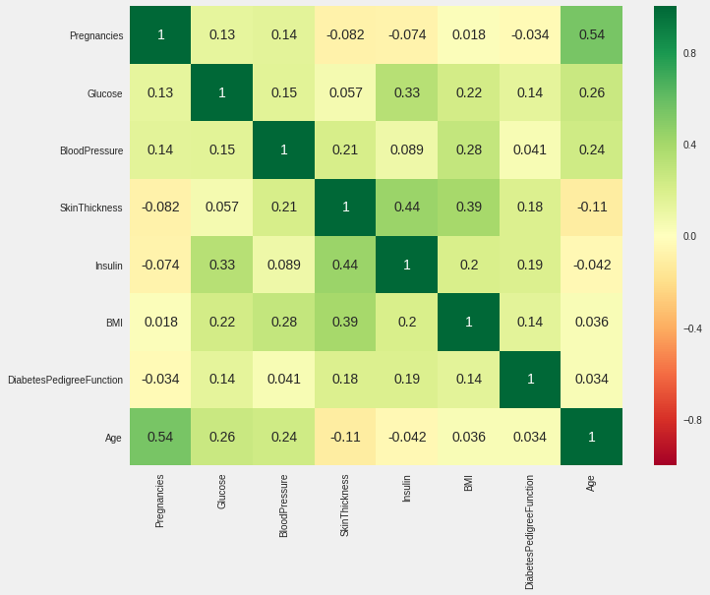
Why don’t general recommendations work?
a.k.a. Why personalized nutrition? (Get rid of the Pundits?)
Food isn’t the same to everyone

Slide 13
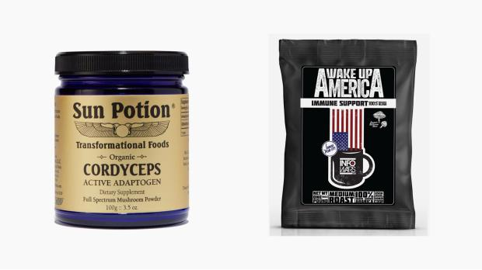
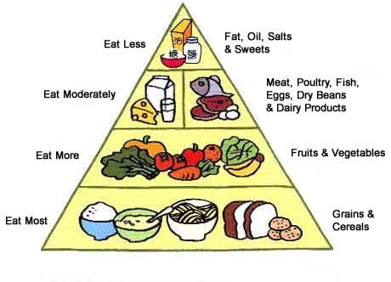
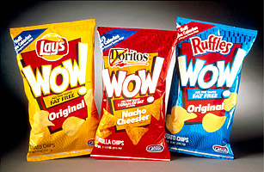
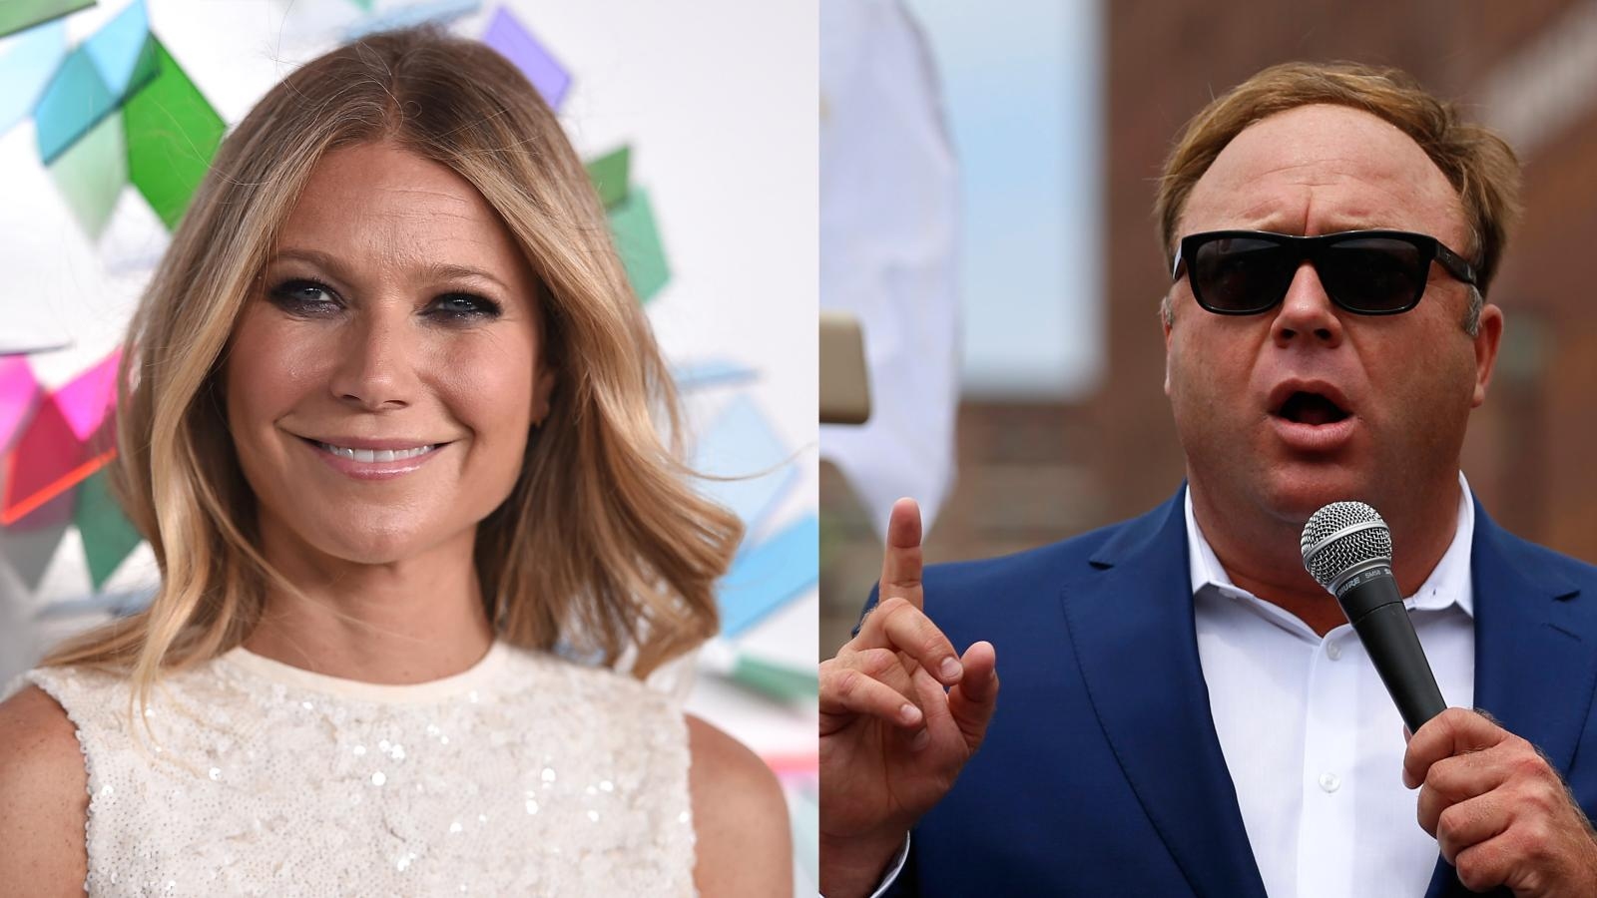
Food Establishment Pop Science
Infowars
Alex Jones
Gwyneth Paltrow
GOOP
USDA
CDC
USDA Foods/School Lunch
Harvard
Nature
CPG
Notes:
Two problems:
Academic Field has been wrong for decades (including publishing questionable research) and there is no consensus
Some of the most popular and unreliable media sites also sell nutrition (click bait + supplements)
https://qz.com/1010684/all-the-wellness-products-american-love-to-buy-are-sold-on-both-infowars-and-goop/

Slide 14
Re-establish nutrition as a science
Replace
Replace Reductionist theory with a Holistic, multi-parameter, systems approach
Replace
Replace standard nutrition studies with ML
Replace
Replace one-size-fits-all recommendations with personalized nutrition
Notes:
How we begin to rebuild that trust and re-establish nutrition as a science:
Traditional: Reductionist theory outdated → fuels confusion and food marketing
Data Science: Holistic multi-parameter approach. Ex: look at influence of the nutrients on gene expression, genetic variations and interaction with environmental factors (i.e. impact of lifestyle on gut microbiome)
Study of biological mechanisms at a single gene or protein level generalized to population level. Crazy because we still don’t know how nutrition at the cellular level translates to health outcomes at the individual level and even population level. This used to be relevant when we studied diseases of deficiency, For example: scurvy, which could be treated with Vitamin C. However the diseases of today are not stemming from deficiency, but from overabundance.
Traditional: Clinical trials are the gold standard, but they’re impossible to achieve without flaws
Data Science: N-of-1 design, Simulated in silico studies
Two types of studies: observational and clinical trials
Observational Studies suck:
Can you remember what you ate yesterday? Last week? Last year? DId you eat more broccoli this year or last year?
Observational studies highly inaccurate, dietary assessment methods and FFQs rely on memory
People can’t remember or they lie, or both
Traditional: One-size-fits-all recommendations don’t work at population level
Data Science: ML architecture integrated with large-scale clinical data are capable of taking into account the inter-individual variability to an assigned diet and could help in moving away from the standardized approach of making general nutrition related recommendations

Slide 15
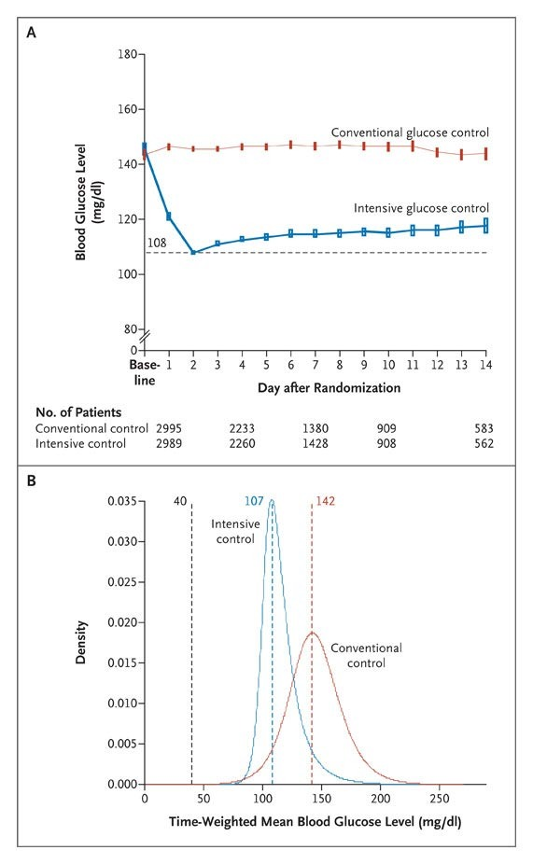
RCT
Poor adherence
Limited in scope
Compares two treatments
$$$$

Slide 16
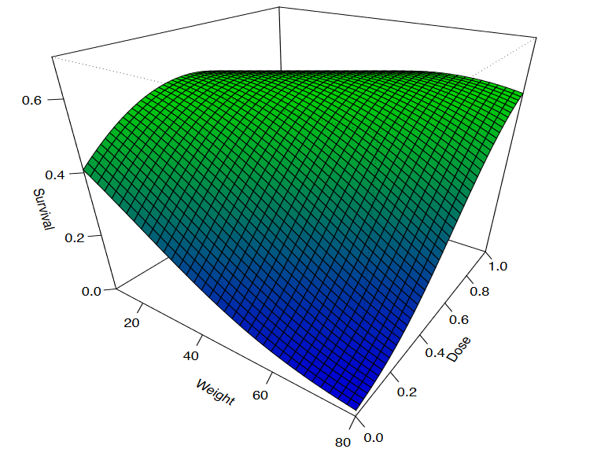
ML
Prediction
Unlimited Data
Better Computation
Maurits Kaptein, PhD (Nth Iteration Lab)

Slide 17
Human-led and human-centered care

Slide 18
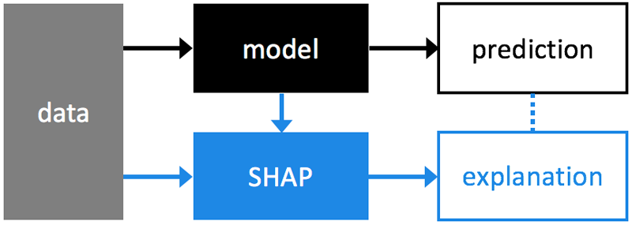
Model Explainability (Could be the solution to Nutrition Industry)
Confounding problem in statistics
Data Science can add transparency and visibility that is lacking
Machine Learning (are explainable)
Yellowbrick- Visual Diagnostic
AutoML (Many Companies doing MLI): Machine Learning Interpretability...automatically
SHAP: Unified approach to explaining any model

Slide 19
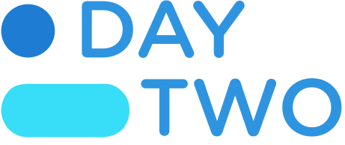
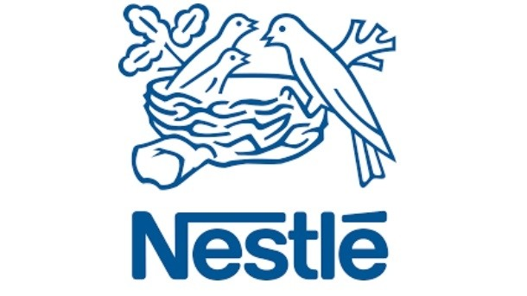
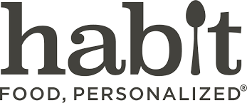
Opportunities for Better Consumer Products
Digital Recommendations
Food, Health and Pharma
Commercialization of Research
Notes:
Digital Recommendations: Personalized nutrition with input from lab data, EHR, Wearables, Apps (Nutrino Suggestic, DayTwo)
Food, Health and Pharma: Discovery of new biopeptides, synergistic compounds. Tailored food programs. (Nuritas, Habit, Nestlé Wellness Ambassador Program)
Commercialization of Research: Democratized research, cloud based platforms (Medrio, Medidata, ProofPilot)

Slide 20
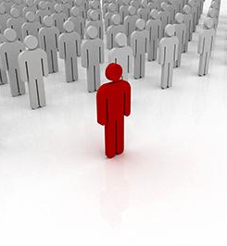
Opportunities for Better Research
Research methods:
Embrace AI, ML and Data Science
Computational Approaches to Personalization Research:
In Silico Clinical Trials, N of 1 Designs, digital observational studies
Notes:
In the age of machine learning, keeping the randomized control trial as gold standard is unethical
In Vitro → In Silico Clinical Trials
(i) develop synthetic patient populations from large-scale clinical data
N of 1 study designs
aren’t new. But until now, there hasn’t been much progress on computational methods to make sense of them. With ML, we can analyze large swaths of data, keeping each participant as their own control.
N-of-1 design:
Participant is his own control within a multiple crossover design
Instead of randomizing the participants, time periods of treatment exposure are randomized.

Slide 21
Opportunities for Better Policy
Recommendations: Retire the food pyramid
Transparency: Decentralized, democratized nutrition programs
Goals:
Disease prediction and prevention
Personalized nutrition recommendations
Prevention strategies that actually work

Slide 22
1955
“Basic 4”
1992
Food pyramid
2011
Myplate
1977
“Hassle-free food guide” by Dr. Hegsted
(Sugar becomes a food group!)
2005
Mypyramid
2019+
Personalized Nutrition
1943
“Basic 7”

Slide 23
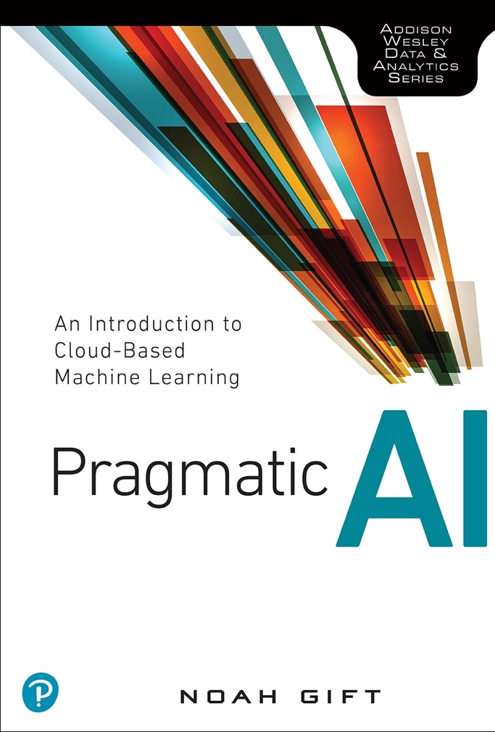
Thank You
Michelle Davenport, PhD, RD (Quantitative Nutrition)
drmichelledavenport.com
Noah Gift, ML Lecturer (Berkeley, Davis, Northwestern)
noahgift.com
Talk Jupyter Notebooks:
https://noahgift.github.io/sugar/topics/sugar.html

